Slide 1
Lecture 12
Topics: Exception Handling
Chapter 12, Sections 12.1 - 12.3

Slide 2

Risky Behavior
Stuff happens: The file isn't there, the server goes down…
No matter how good a programmer you are, things can still go very wrong.
But how do you know when a method or code is risky?
We need to handle code that we cannot guarantee will work at runtime - code that expects the file to be in the right directory or the server to be up and running.

Slide 3
Exception Handling
Exception handling enables a program to deal with exceptional situations and then continue its normal execution.
Runtime errors: Occur while a program is running if the JVM detects an operation that is impossible to carry out.
Example: If you try to access an array using an invalid index, you will get a runtime error with an ArrayIndexOutOfBoundsException.
In Java, runtime errors are thrown as exceptions.

Slide 4
What are exceptions?
An exception is an object of type Exception.
There is a Java class named Exception.
The Exception class extends the Throwable class and the Throwable class directly extends Object.
The Exception class has 75 direct (child) subclasses and many of those subclasses have subclasses.

Slide 5
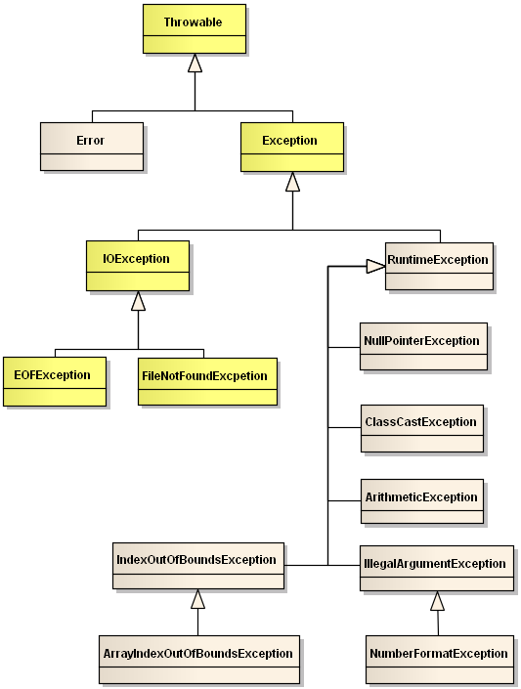
http://msoe.us/taylor/tutorial/se1021/exceptionUML.png

Slide 6
Working with exceptions
An exception is an object that signals the occurrence of an unusual event during the execution of a program.
The process of creating this object (generating an object of type Exception) is called throwing an exception.
The code that detects and deals with exception is said to handle the exception.
Notes:
Hence, this is why it inherits from Throwable

Slide 7
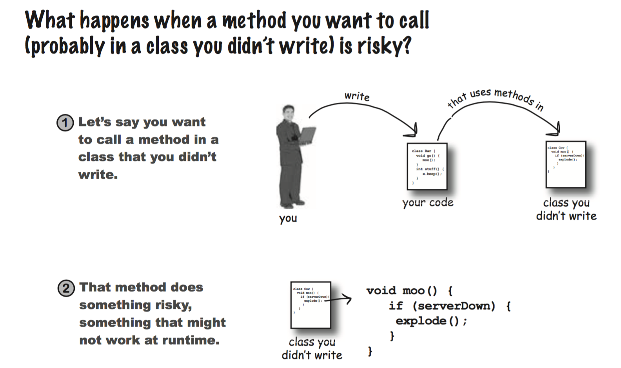

Slide 8
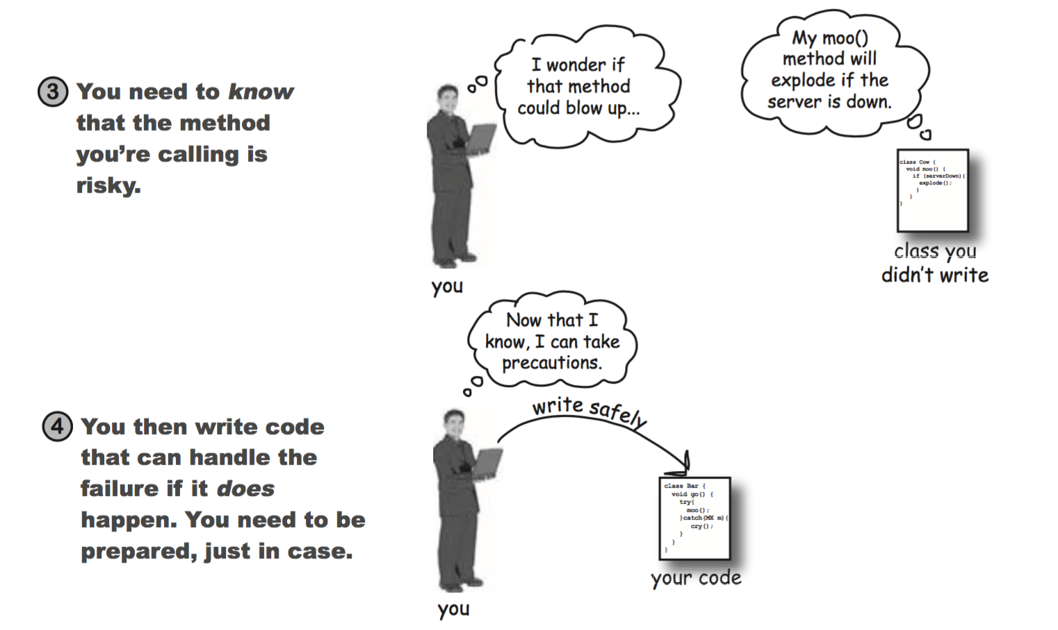

Slide 9
Try-Catch Block
try
{
// Do risky thing
// Risky thing throws an exception
// More Code
} catch (Exception e) {
// Try to recover
}
The catch block looks like a method definition (even though it is not) and behaves like a method in some ways.
The reference variable e looks and acts like a method parameter and is local to the catch block.
The try block is always followed by a catch block.

Slide 10
Try-Catch Block
try
{
// Do risky thing
// Risky thing throws an exception
// More Code
} catch (Exception e) {
// Try to recover
}
When an exception object is thrown, it is plugged in for the catch block parameter e and the code in the catch block is executed.
The class name preceding the catch block parameter specifies what kind of exception the catch block can catch.
In the above example, the class name Exception indicates that the thrown exception must be of type Exception.

Slide 11
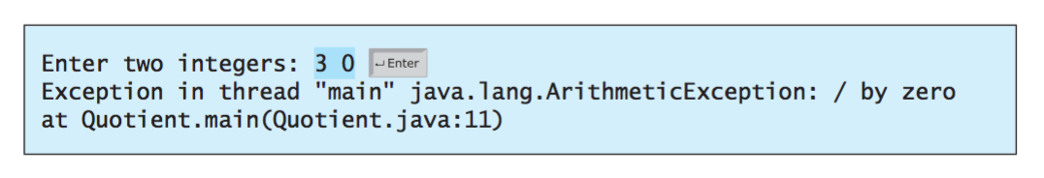
What is potentially wrong with this code?
public static void main(String[] args)
{
Scanner input = new Scanner(System.in);
System.out.print("Enter two integers: ");
int num1 = input.nextInt();
int num2 = input.nextInt();
System.out.println(num1 + " / " + num2 + " is " + (num1/num2));
}
An arithmetic exception (object!!) was thrown

Slide 12
public static void main(String[] args)
{
Scanner input = new Scanner(System.in);
System.out.print("Enter two integers: ");
int num1 = input.nextInt();
int num2 = input.nextInt();
if (num2 != 0)
System.out.println(num1 + " / " + num2 + " is " + (num1/num2));
else
System.out.println("Divisor cannot be zero");
}
This is not exception handling, although it does address the problem.

Slide 13
import java.util.Scanner;
public class QuotientWithException
{
public static void main(String[] args)
{
Scanner input = new Scanner(System.in);
System.out.print("Enter two integers: ");
int num1 = input.nextInt();
int num2 = input.nextInt();
try
{
if (num2 == 0)
{
throw new ArithmeticException();
}
int result = num1/num2;
System.out.println(num1 + " / " + num2 + " is " + result);
}
catch (ArithmeticException e)
{
System.out.println("Exception: Cannot divide by zero ");
}
System.out.println("Execution continues ...");
}
}
If num2 is 0, the code will throw an ArithmeticException.
Execution will immediately stop because we are in a try block.
It will go to the catch block and execute the code in the catch block.
Then it will go to the next line outside of the try-catch block.
Notes:
Note the new keyword - you're making a new object.

Slide 14

import java.util.Scanner;
public class QuotientWithException
{
public static void main(String[] args)
{
Scanner input = new Scanner(System.in);
System.out.print("Enter two integers: ");
int num1 = input.nextInt();
int num2 = input.nextInt();
try
{
if (num2 == 0)
{
throw new ArithmeticException();
}
int result = num1/num2;
System.out.println(num1 + " / " + num2 + " is " + result);
}
catch (Exception e)
{
System.out.println("Exception: Cannot divide by zero ");
}
System.out.println("Execution continues ...");
}
}
These are different. Will the catch block still handle the ArithmeticException?
Yay for polymorphism!
ArithmeticException extends RuntimeException, which extends Exception, which extends Throwable.

Slide 15
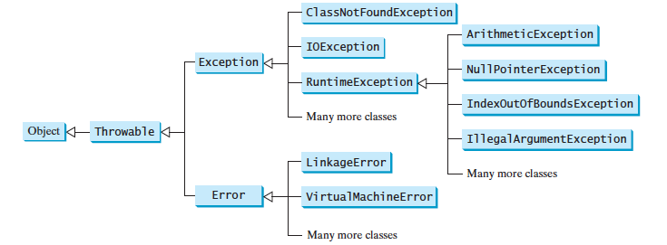

Slide 16
Methods and Exception Handling
A method can throw an exception when something fails at runtime.
The method call should be placed inside of a try-catch block.
Methods can throw exceptions in two ways. We will talk about the second way on Thursday.
Methods can throw more than one exception.
This is why polymorphism is so important in exception handling.

Slide 17
import java.util.Scanner;
public class QuotientWithException
{
public static void main(String[] args)
{
Scanner input = new Scanner(System.in);
System.out.print("Enter two integers: ");
int num1 = input.nextInt();
int num2 = input.nextInt();
try
{
int result = quotient(num1, num2);
System.out.println(num1 + " / " + num2 + " is " + result);
}
catch (ArithmeticException e)
{
System.out.println("Exception: Cannot divide by zero ");
}
System.out.println("Execution continues ...");
}
public static int quotient(int n1, int n2)
{
if (n2 == 0)
throw new ArithmeticException();
return n1/n2;
}
}
If n2 is 0, the code will throw an ArithmeticException.
Execution will immediately stop and the method will throw the exception back to the main method.
The catch block will catch it and execute the code in the catch block.
Then it will go to the next line outside of the try-catch block.

Slide 18

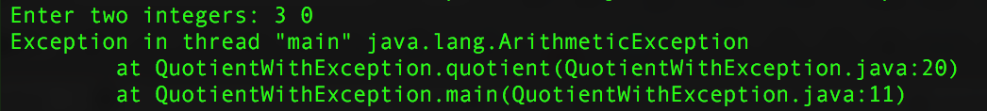
What happens if my method throws an exception and I don't have a try-catch block?
import java.util.Scanner;
public class QuotientWithException
{
public static void main(String[] args)
{
Scanner input = new Scanner(System.in);
System.out.print("Enter two integers: ");
int num1 = input.nextInt();
int num2 = input.nextInt();
int result = quotient(num1, num2);
System.out.println(num1 + " / " + num2 + " is " + result);
}
public static int quotient(int n1, int n2)
{
if (n2 == 0)
throw new ArithmeticException();
return n1/n2;
}
}
As long as your exception is not a special kind of exception called a checked exception, the code will run.

Slide 19
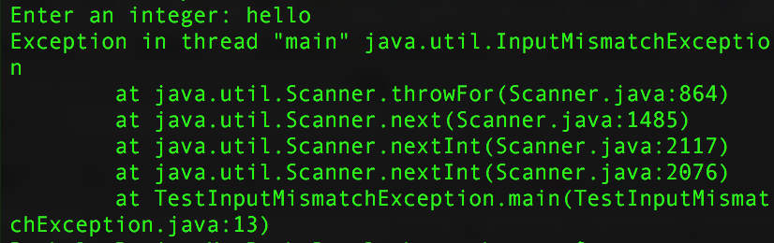
Example
import java.util.Scanner;
public class TestInputMismatchException
{
public static void main(String[] args)
{
Scanner kb = new Scanner(System.in);
int num = 0;
do
{
System.out.print("Enter an integer: ");
num = kb.nextInt();
System.out.println("Num is: " + num);
} while (num > 0);
}
}
What happens if the user enters a String or a character?
InputMismatchException!!

Slide 20
InputMismatchException
Thrown by a Scanner object to indicate that the value retrieved does not match the pattern for the expected type, or that the value is out of range for the expected type.
Extends the NoSuchElementException class.
The NoSuchElementException class extends the RuntimeException class.
The RuntimeException class extends the Exception class.
The Exception class extends the Throwable class.

Slide 21

import java.util.Scanner;
public class TestInputMismatchException
{
public static void main(String[] args)
{
Scanner kb = new Scanner(System.in);
int num = 0;
do
{
System.out.print("Enter an integer: ");
try
{
num = kb.nextInt();
System.out.println("Num is: " + num);
} catch (InputMismatchException e) {
System.out.println("Try again.");
kb.nextLine();
}
} while (num > 0);
}
}
The nextInt() method from the Scanner class throws the exception.
You just have to catch it using a try-
catch block.
And how did we know that the nextInt()
method throws an exception??

Slide 22
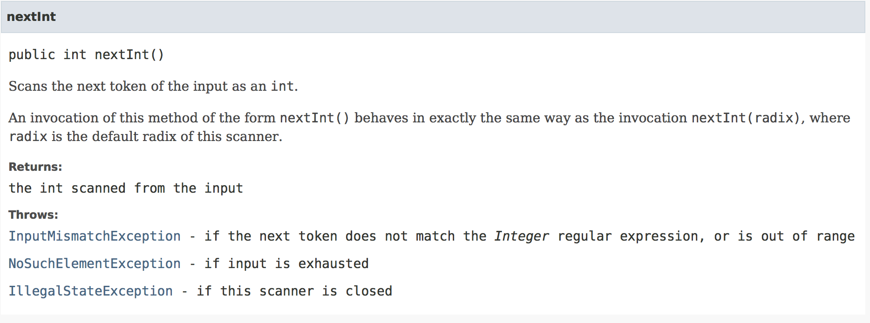
Java Docs!!!

Slide 23
NumberFormatException
Thrown to indicate that the application has attempted to convert a string to one of the numeric types, but that the string does not have the appropriate format.
Extends IllegalArgumentException.
IllegalArgumentException extends RuntimeException
RuntimeException extends Exception
Exception extends Throwable.

Slide 24
Methods that throw NumberFormatException
Integer.parseInt(s), Double.parseDouble(s), Float.parseFloat(s), etc.
Integer.valueOf(s), Double.valueOf(s), Float.valueOf(s), etc.

Slide 25
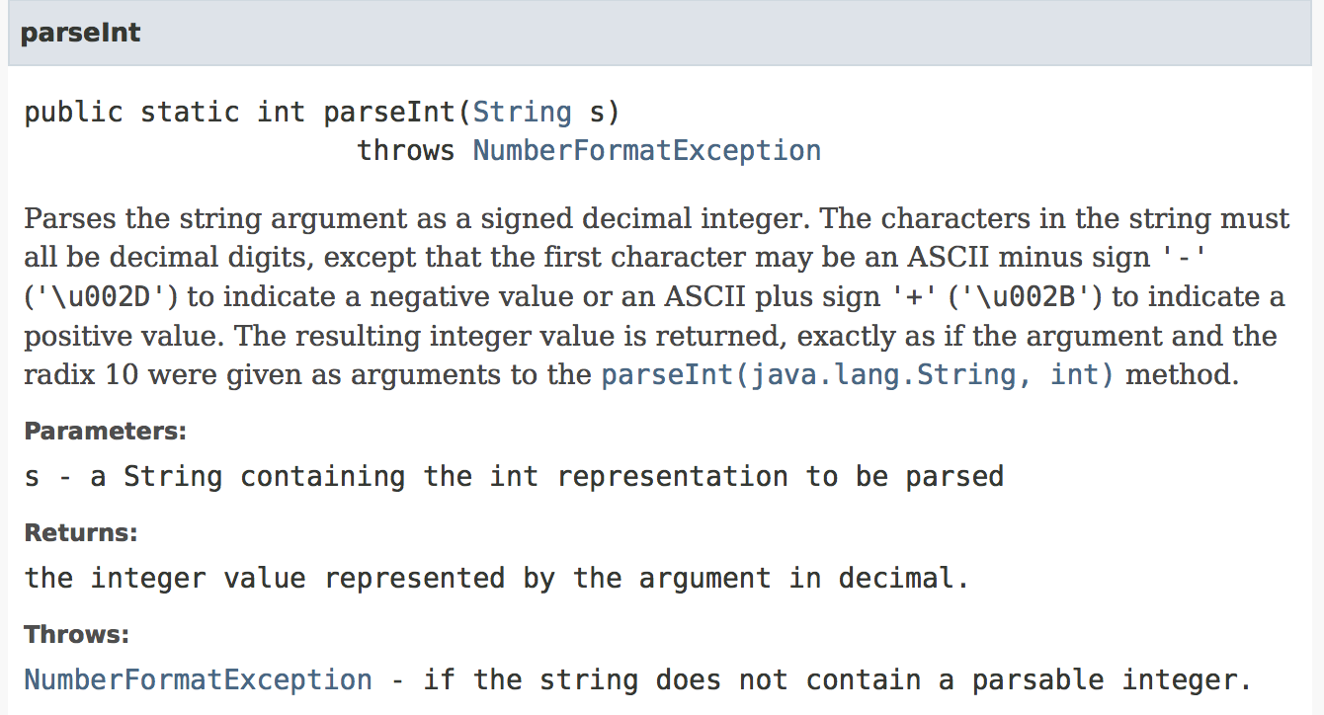

Slide 26
import java.util.Scanner;
public class TestNumberFormatException
{
public static void main(String[] args)
{
Scanner kb = new Scanner(System.in);
String s = "end";
do
{
System.out.print("Enter a numerical String: ");
try
{
s = kb.nextLine();
int n = Integer.parseInt(n);
System.out.println("Number is: " + n);
} catch (NumberFormatException e) {
System.out.println("Not a valid integer.");
}
} while (!s.equals("end"));
}
}

Slide 27
ArrayIndexOutOfBoundsException
Thrown to indicate that an array has been accessed with an illegal index. The index is either negative or greater than or equal to the size of the array.
Extends IndexOutOfBoundsException.
IndexOutOfBoundsException extends RuntimeException
RuntimeException extends Exception
Exception extends Throwable.

Slide 28
public static String hyphenMixUp(String s)
{
boolean hasHyphen = s.matches(".*-.*");
String[] parts = s.split("-");
String s2 = s;
if (hasHyphen)
{
try
{
String front = parts[0].replaceAll("[aeiou]", "");
String end = parts[1].replaceAll("[0-9]", "");
s2 = front + "-" + end;
} catch (ArrayIndexOutOfBoundsException e) {
String front = parts[0].replaceAll("[aeiou]", "");
s2 = front + "-";
}
}
return s2;
}

Slide 29
StringIndexOutOfBoundsException
Thrown by String methods to indicate that an index is either negative or greater than the size of the string. For some methods such as the charAt method, this exception also is thrown when the index is equal to the size of the string.
Extends IndexOutOfBoundsException.
IndexOutOfBoundsException extends RuntimeException
RuntimeException extends Exception
Exception extends Throwable.

Slide 30
public class TestStringIndexOutOfBoundsException
{
public static void main(String[] args)
{
try
{
String s = "I love to program I love to program";
char c = s.charAt(0);
c = s.charAt(50);
} catch (StringIndexOutOfBoundsException e) {
System.out.println("Nope. You can't do this.");
}
}
}

Slide 31
What type of exception will the program throw?
public class Test
{
public static void main(String[] args)
{
int[] list = new int[5];
System.out.println(list[5]);
}
}
public class Test
{
public static void main(String[] args)
{
String s = "abc";
System.out.println(s.charAt(3));
}
}
ArrayIndexOutOfBoundsException
StringIndexOutOfBoundsException
public class Test
{
public static void main(String[] args)
{
System.out.println(1 / 0));
}
}
public class Test
{
public static void main(String[] args)
{
System.out.println(1.0 / 0);
}
}
ArithmeticException
Infinity

Slide 32
What type of exception will the program throw?
public class Test
{
public static void main(String[] args)
{
Object o = null;
System.out.println(o.toString());
}
}
public class Test
{
public static void main(String[] args)
{
Object o = new Object();
String d = (String)o;
}
}
NullPointerException
ClassCastException

Slide 33
Recap
Depending on what you are trying to do, you can explicitly check for a condition and then throw an exception if that condition is not met (see slide 13).
You can also create a method that explicitly throws an exception based on whether or not a condition is met (see slide 17).
Many methods in Java API classes throw exceptions that you can handle using the try-catch block.
Exceptions are objects (and thus allow for polymorphic behavior).

Slide 34
When should I implement exception handling?
Handling too many exceptions can make the code unclear.
Simple errors that can be done by using if-statements to check for errors (for example, dividing by 0).
Use it to deal with unexpected error conditions (for example, the user entering the wrong type of input).
Note: You will be implementing exception handling in simple situations in your homework assignments for the purpose of learning how to do exception handling.

Slide 35

That’s all for today!
We will go into exception handling in more detail on Thursday!

